Slide 1
Spring Configuration Using XML

Slide 2
Why Use XML?
First approach
Simpler
Separation of concerns

Slide 3
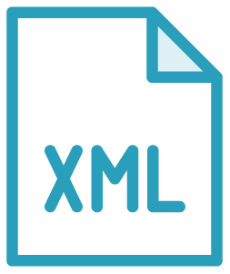
applicationContext.xml
Name doesn’t matter
Spring Context sort of a HashMap Can simply be a registry
XML configuration begins with this file Namespaces aid in configuration/validation

Slide 4
Namespaces
<beans xmlns="http://www.springframework.org/schema/beans" xmlns:xsi="http://www.w3.org/2001/XMLSchema-instance" xsi:schemaLocation="http://www.springframework.org/schema/
beans http://www.springframework.org/schema/beans/spring- beans.xsd">

Slide 5
XML Declaration
<bean
name=“customerService” class="com.mycompany.service.CustomerServiceImpl" autowire=“byName">
<property name="0"
ref="customerRepository" />
</bean>

Slide 6
<bean name=“customerRepository" class= "com.mycompany.repository.HibernateCustomerRepositoryImpl" />
Beans
Essentially classes
Replaces keyword new Define class, use interface

Slide 7
Setter Injection
Setter injection
Constructor injection
Used together
Better for existing code

Slide 8
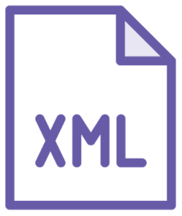
Constructor Injection
Guaranteed contract
Constructor defined Used together Index-based

Slide 9
Autowire
Spring automatically wires beans
byType
byName
constructor
no

Slide 10
applicationContext.xml
Bean definition Setter injection Constructor injection Autowiring
Summary

